Slide 1
React Angular Vue
Let’s Start Our Journey

Slide 2
Table of contents
01
02
03
04
05
06
Frameworks
Origins
Learning Curve
Core Concepts
Data Binding
Code Structure
Performance, Job Market

Slide 3
01
Frameworks Origin
We’ll know our Frameworks Origin

Slide 4
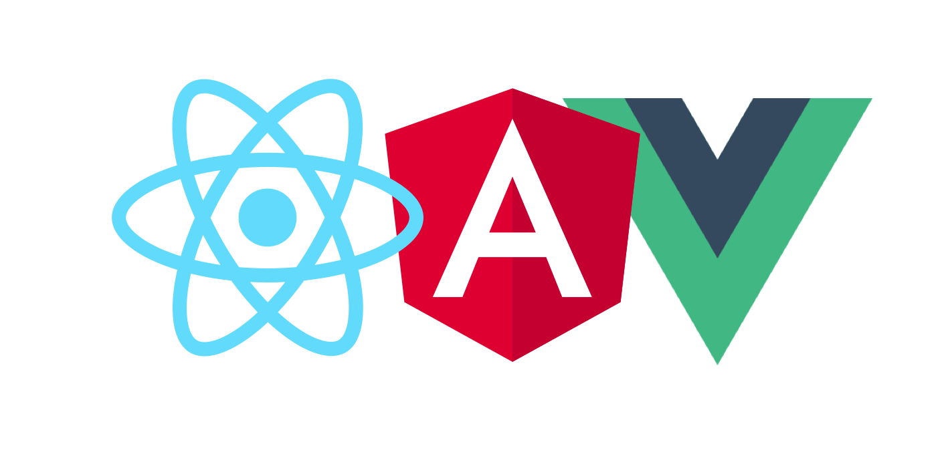
01. Frameworks Origin
Angular
Developed and maintained by Google.
A comprehensive and opinionated framework that comes with a set structure
and conventions.
React
Known for its simplicity and flexibility.
Developers can start with a basic understanding and gradually explore more
advanced concepts.
Vue
Created by Evan You, a former Google engineer who worked on Angular.
Positioned as a progressive framework, allowing developers to incrementally adopt its features.

Slide 5
Why React is not a framework?

Slide 6
Why React is not a framework?
React is commonly used in conjunction with additional libraries like
React Router for routing and Redux
for state management.
Frameworks like Angular and Vue
include features like routing,
State management, and
form handling

Slide 7
02
Learning Curve
We’ll know About Learning Curve

Slide 8
02. Learning Curve
React
Known for its simplicity and flexibility.
Developers can start with a basic understanding and gradually explore more advanced concepts.
Angular
Vue
Has a steeper learning curve due to its extensive and opinionated structure.
Utilizes TypeScript, which may require additional learning for developers unfamiliar with it.
Considered the easiest to learn among the three.
Offers a gentle learning curve, making it accessible to beginners

Slide 9
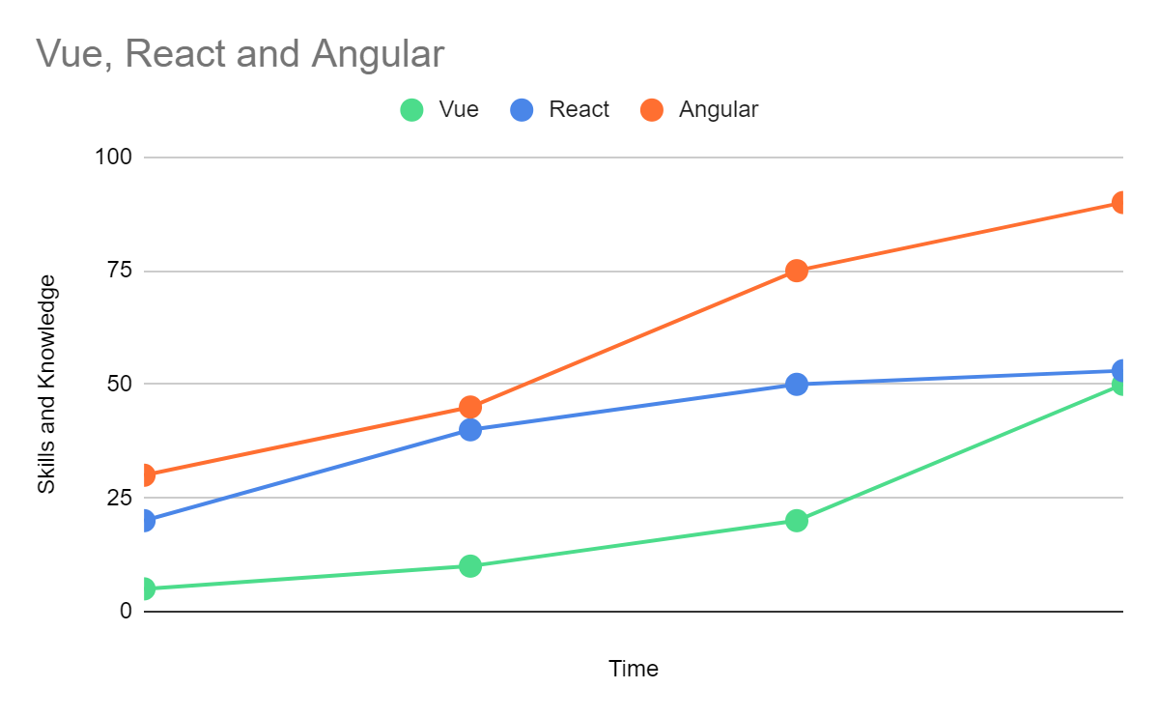
Learning Curve
While Angular has the most difficult learning curve, investing time in learning Angular will make you an expert in front-end development. The learning curve for React varies from one app to another and Vue has the shortest learning cure

Slide 10
03
Core Concept
We’ll know About our Core Concept

Slide 11
03. Core Concepts
Angular
React
Includes directives, modules, components, services, pipes,
templates, and TypeScript.
Includes components, managing internal state, props, and JSX.
Vue
Includes components, directives, templates, and a flexible reactivity
system.

Slide 12
04
Code Structure
We’ll know About our Code Structure

Slide 13
Angular
React and Vue
04. Code Structure
Enforces a specific structure, promoting consistency across projects.
Offers a modular approach with a clear separation of concerns.
Provide flexibility in structuring code, allowing developers to choose the architecture that suits their needs.
Encourages the use of external libraries or patterns (like Redux for React) for state
management.

Slide 14
05
Performance & Job Market
We’ll know About Performance and Job Market

Slide 15



05.1 Performance
Angular
React
Vue
Uses real DOM
Slower Performance in case of frequent updates
Uses Virtual DOM
Minimum re-rendering required
Uses Virtual DOM
Efficient memory allocation

Slide 16
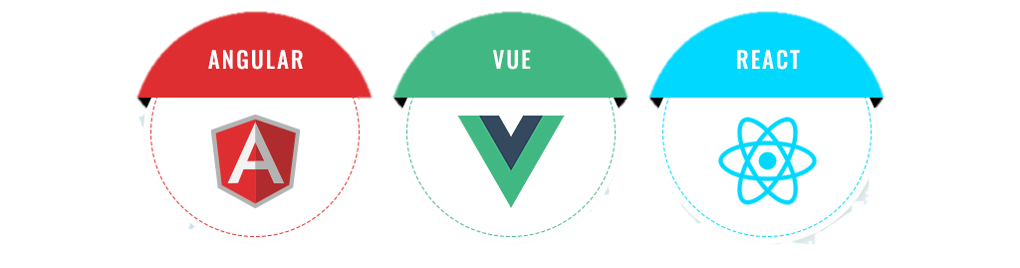
05.2 Job Market
Linkedin
Indeed
SimplyHired

Slide 17
06
Data Binding
We’ll know About Data Binding

Slide 18
06. Data Binding
Angular
Vue
React
Two-way
Data
Binding
Supports both one-way and
two-way data binding
One-way
Data
Binding

Slide 19
Thanks!
Do you have any questions?

Slide 20
Let’s watch our live demo

